Slide 1
PROGRESS REPORT ON ML-assisted Signal Quality Assessment of PPG Signals With Related Hardware Implementation
Presented By:
Archana Kumari
Univ. Roll no.– T91/ECE/204058
Univ Registration no.– D01-1211-0077-20
Shwashwat Das
Univ Roll no.– T91/ECE/204074
Univ Registration no.– D01-1111-0206-20
B.Tech in Electronics and Communication Engineering
Supervisor:
Dr. SUMITRA MUKHOPADHYAY
(Department of Radio Physics and Electronics, University of Calcutta)

Slide 2
Contents:
Composition of Dataset
Annotation : Outcome
Features Extracted
Model trained and its performance
Doubts

Slide 3
Dataset prepared from different sources
Dataset names | No. of Subjects | Time length | Segments per patient |  |  | Total no. of 10s windows from each dataset (overlapping windowing 10s / 6s)
MIMIC 3 (125Hz) | 17 | 10min | 99 | = | = |  | 1683 | 1683
BIDMC (125Hz) | 18 | 8min | 79 | = | = |  | 1422 | 1422
DaLiA (64Hz) | 15 | 10min | 99 | = | = |  | 1485 | 1485
MIMIC_PERForm AF (125Hz) | 19 | 10min | 99 | = | = |  | 1881 | 1881
CSL (125Hz) | 2 | 10min | 99 | = | = |  | 198 | 198
TOTAL | 71 |  |  |  | Test -3144, Train - 3144 |  | 6669 | 6669

Slide 4
Annotation : Outcome
Segment length = 10 seconds
Number of segments = 6669
Distribution:
Ratio of Clean to (Partly clean + Corrupted) is about 0.785
Class -> | Clean | Partly clean | Corrupted
Number of segments -> | 2933 | 3088 | 648

Slide 5
Features Extracted
FEATURES: | MAX : 80
1. Morphological: (7) | pulse amplitude; (2) pulse length; (3) peak distance; (4) trough depth difference; (5) peak height difference; (6) pulse skewness; and (7) pulse kurtosis.
2. AE: (approx. 40) | 40 (approx)
3. Statistical: 16 | Time: Mean, Standard deviation, Root mean square (RMS), Skewness, Kurtosis, Interquartile range (IQR), Pulse rate (PR), Heart rate variability (HRV), Pulse amplitude (PA), Pulse width, Rise time, Fall time, Dicrotic notch Frequency: Dominant frequency, Power spectral density (PSD), Spectral entropy, Band power
4. Entropy: 15
5. DWT: 2

Slide 6
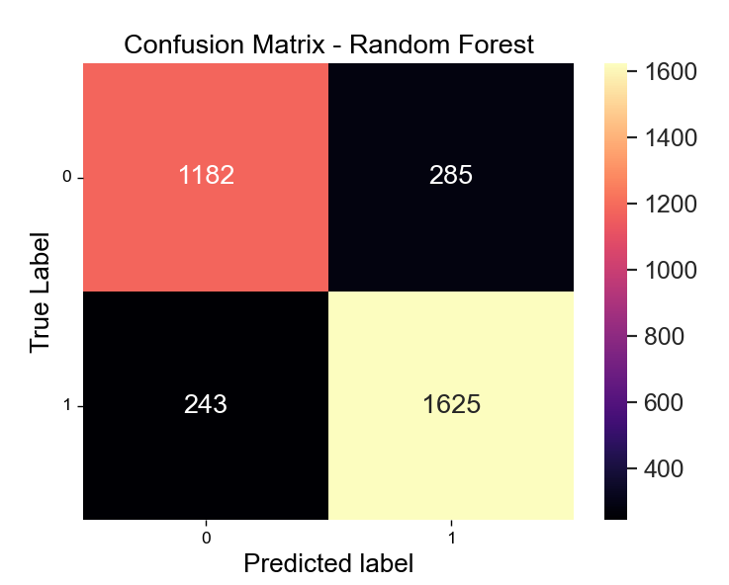
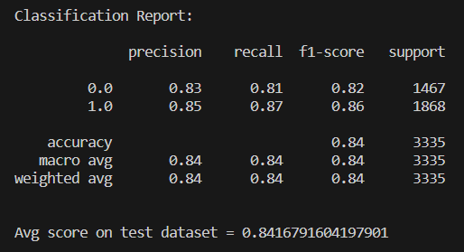
Model trained and its performance
Model used: Random Forest
Split Criteria : Gini
Intra-patient performance:
Train test ratio = 50:50
Trees in model: 50 trees

Slide 7
Doubts
Optimal number of features
Should we use in-built libraries or write our own functions?
Board ?
Algorithm for peak detection?
Our second stage: supervised or unsupervised?

